Slide 1
Relational Calculus
Examples and Exercises

Slide 2
What is Relational Calculus?
A non-procedural query language for relational databases.
Describes what to retrieve rather than how to retrieve it .
each query is of the form:
{t | P (t ) }

Slide 3
Query Formation
each query is of the form
{t | P (t ) }
It is the set of all tuples(rows) t such that predicate P is true for t
t is a tuple variable
t [A ] denotes the value of tuple t on attribute A
t ∈ r denotes that tuple t is in relation r
P is a formula similar to that of the predicate calculus

Slide 4
Operation Operators
Set of comparison operators: (e.g., <, ≤, =, ≠, >, ≥)
Set of connectives: and (∧), or (v)‚ not (¬)
Implication (⇒): x ⇒ y, if x if true, then y is true
x ⇒ y ≡ ¬x v y
Set of quantifiers:
∃ t ∈ r (Q (t )) ≡ ”there exists” a tuple in t in relation r such that predicate Q (t ) is true
∀t ∈ r (Q (t )) ≡ Q is true “for all” tuples t in relation r

Slide 5
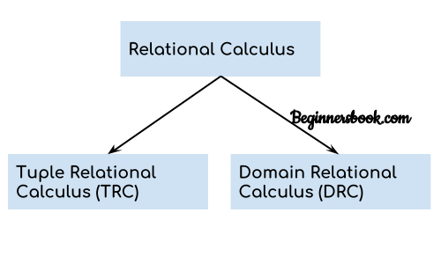
Types of Relational Calculus
Two main types:
Tuple Relational Calculus (TRC)
Domain Relational Calculus (DRC).

Slide 6
Tuple Relational Calculus(TRC)
Definition: It is a non-procedural query language which is based on finding a number of tuple variables/ results also known as range variable for which predicate / conditions holds true
TRC is based on tuples.
Query: { t | P(t) }

Slide 7
Tuple Relational Calculus(TRC)
Queries are expressed as: { t | P(t) } OR {T | Condition (T)}
Where, T is the resulting tuples(rows)
And P(T) is the condition used to fetch T.
Again, P(T) also called predicate

Slide 8
Example of TRC
Find the ID, name, dept_name, salary for instructors whose salary is greater than $50,000
{t | t ∈ instructor ∧ t [salary ] > 80000}

Slide 9
Safety of Expressions
It is possible to write tuple calculus expressions that generate infinite relations.
For example, { t | ¬ t ∈ Employee } – unsafe because it tries to list all tuples not in the relation Employee.

Slide 10
Cause of Unsafe
Infinite Domain Problem: In a relational calculus query, when you specify something like { t | ¬ t ∈ Employee } it implies that you are trying to retrieve all possible tuples that do not exist in the Employee relations
Non-Termination: The query would result in non-termination because the system would attempt to evaluate all tuples that do not belong to the relation, and this set could be infinitely large.

Slide 11
Cause of Unsafe
Lack of Boundedness: Safe queries in relational calculus are typically bounded, meaning they return a finite set of results from a finite domain. In this case, since you're asking for all tuples outside of a relation, the result is not bounded by the existing relation (e.g. Employee) leading to an unsafe query.

Slide 12
Safe Expressions
To make the expression { t | ¬ t ∈ Employee } safe
Need to restrict the domain of tuples so that the result is finite and computable
Using a Projection to Restrict Attributes

Slide 13

Using Explicit Domain Restriction
Restrict the domain to only tuples that belong to a known, finite relation (e.g., a set of all possible employees or records in a database).
For example, you could restrict the query to only tuples that exist in another relation, say Person where Person contains all possible individuals, and Employee is a subset of Person.

Slide 14

Using a Projection to Restrict Attributes
You can restrict the query to a projection of attributes (e.g., specific attributes of employees, like name, id, etc, instead of considering all possible tuples.

Slide 15
Domain Relational Calculus(DRC)
Definition: DRC means filtering variable uses the domain of attributes
Domain relational calculus uses the same operators as tuple calculus
DRC is based on the domain of attributes.

Slide 16
Domain Relational Calculus(DRC)
Query: { a1, a2, a3, ..., an | P (a1, a2, a3, ... ,an)}
Where a1, a2 are attributes
And P stands for formula built by inner attributes

Slide 17
Example of DRC
Find the ID, name, dept_name, salary for instructors whose salary is greater than $80,000
{< i, n, d, s> | < i, n, d, s> ∈ instructor ∧ s > 80000}

Slide 18
Differences Between TRC and DRC
Tuple Relational Calculus | Domain Relational Calculus
1) Uses tuple variables. | 1) Uses tuple variables.
2) It selects entire tuple | 2) it selects attributes.
3) Less expressive | 3) More expressive

Slide 19
Applications of Relational Calculus
Query optimization
Theoretical foundation for SQL
Basis for query languages in some DBMS systems

